Slide 1
Resume Workshop
Carleton University
Actuarial Science Club

Slide 2
Purpose of a Resume
A resume -> An interview -> A job
Highlight relevant details. DON’T over explain
Elaborate in the interview
You have 30-60 seconds to make an impression
It’s the first thing a recruiter sees about you
Shows value to the employer, “why should they care?”
Demonstrates your written communication and organization skills

Slide 3
What is Expected on a Resume
Well organized, easy to read
What’s in an actuarial resume?
Title
Education
Exams & VEE
Relevant work experience
Leadership / service / activities
Skills and Honours

Slide 4
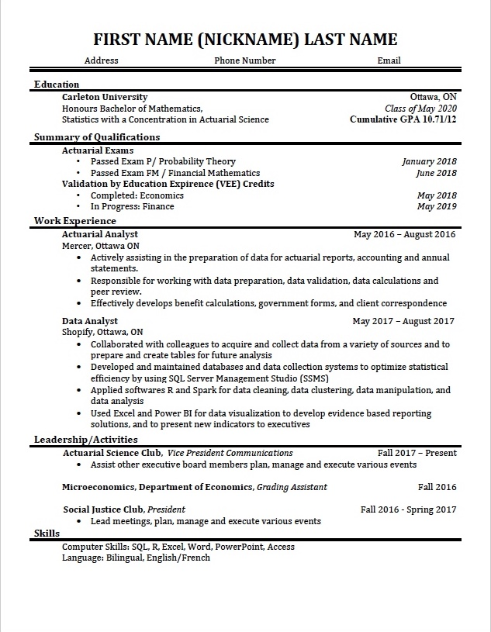
Resume Walkthrough
Over the next few slides, we’ll go over each aspect of the resume and what it should include
Question to remember:
How does your resume differ?
Does your resume have too much white space?
Remember: How will the recruiter see me?

Slide 5
Title
Full Name, Phone #, Email, Address
Title should be size 20+ font
If people have trouble reading your name, include a phonetic spelling or a nickname

Slide 6
Education
School, major(s) and minor(s), graduation date, GPA, Dean’s list
Do not round your GPA
If you CGPA is <9.0, list your major-related GPA OR remove it entirely but be ready for questions about it

Slide 7
Exams & VEE
Passed and/or future sittings
Highlight this in its own section!
Your score is not necessary and is usually considered private information (therefore unless you got a 10 and really want to put it on, you don’t need to)
For most/all situations, the term “passed” will suffice
List any VEE Credits that you’ve earned or plan to earn while at school.

Slide 8
Relevant Work Experience
Internships, Co-ops, Research, Jobs, Leadership Programs & Competitions
Notice the word RELEVANT
Don’t use bullet points to just list what you did, focus on communicating value to the employer

Slide 9
Leadership / Activities
Clubs, service, sports, interests
Communicate value to the employer
Demonstrates initiative, time management skills and personality

Slide 10
Skills & Honours
Programming, Language, Scholarships, Awards
Give concrete examples of proficiency

Slide 11
Tips
Eliminate all spelling and grammatical errors
Try to keep the resume to one page
Focus on transferrable, intangible skills learned from non-actuarial jobs more than technical skills
Use strong wording
Keep it organized
Make it easy to read – make sure your accomplishments stand out
Every line should demonstrate value to the employer
Have several trusted sources look over your resume for constructive criticism

Slide 12
Resources
CU Job Services Resume Guidelines:
https://carleton.ca/career/job-search-support/resume-and-cover-letter-guides/
Website for cover letter resources:
https://www.youthcentral.vic.gov.au/jobs-and-careers/applying-for-a-job/what-is-a-cover-letter/sample-cover-letters

